Slide 1
Lab 5: Exploring Side-Channel Attacks
ECE 371: Intro to Security Engineering

Slide 2
Objectives
Introduction to side-channel attacks
Practice using Python code
Learn how different side-channel attacks work, customize attacks and observe effects

Slide 3
Tools
ChipWhisperer
Used to collect traces (already gathered for you)
Allows user to use default attacks or make their own custom attacks
Integrates easily with Python to analyze and visualize traces

Slide 4
Lab Overview
Download trace files from Moodle
Install Chipwhisperer
Attack the trace file using standard attacks provided by ChipWhisperer
Use automated Side Channel Analysis attacks to recover a password
Report (no demo!)

Slide 5
Part 1 - Download Traces
You are provided with a trace file:
passwords_full.p
You will need to perform various attacks on the trace file

Slide 6
Part 2 - Install Chipwhisperer
We are using Chipwhisperer for this lab
This is not installed on the lab computers currently.. you can use your
personal laptops
Note: ChipWhisperer will work best on Windows 10 or above
Instructions found here: https://chipwhisperer.readthedocs.io/en/latest/windows-install.html

Slide 7
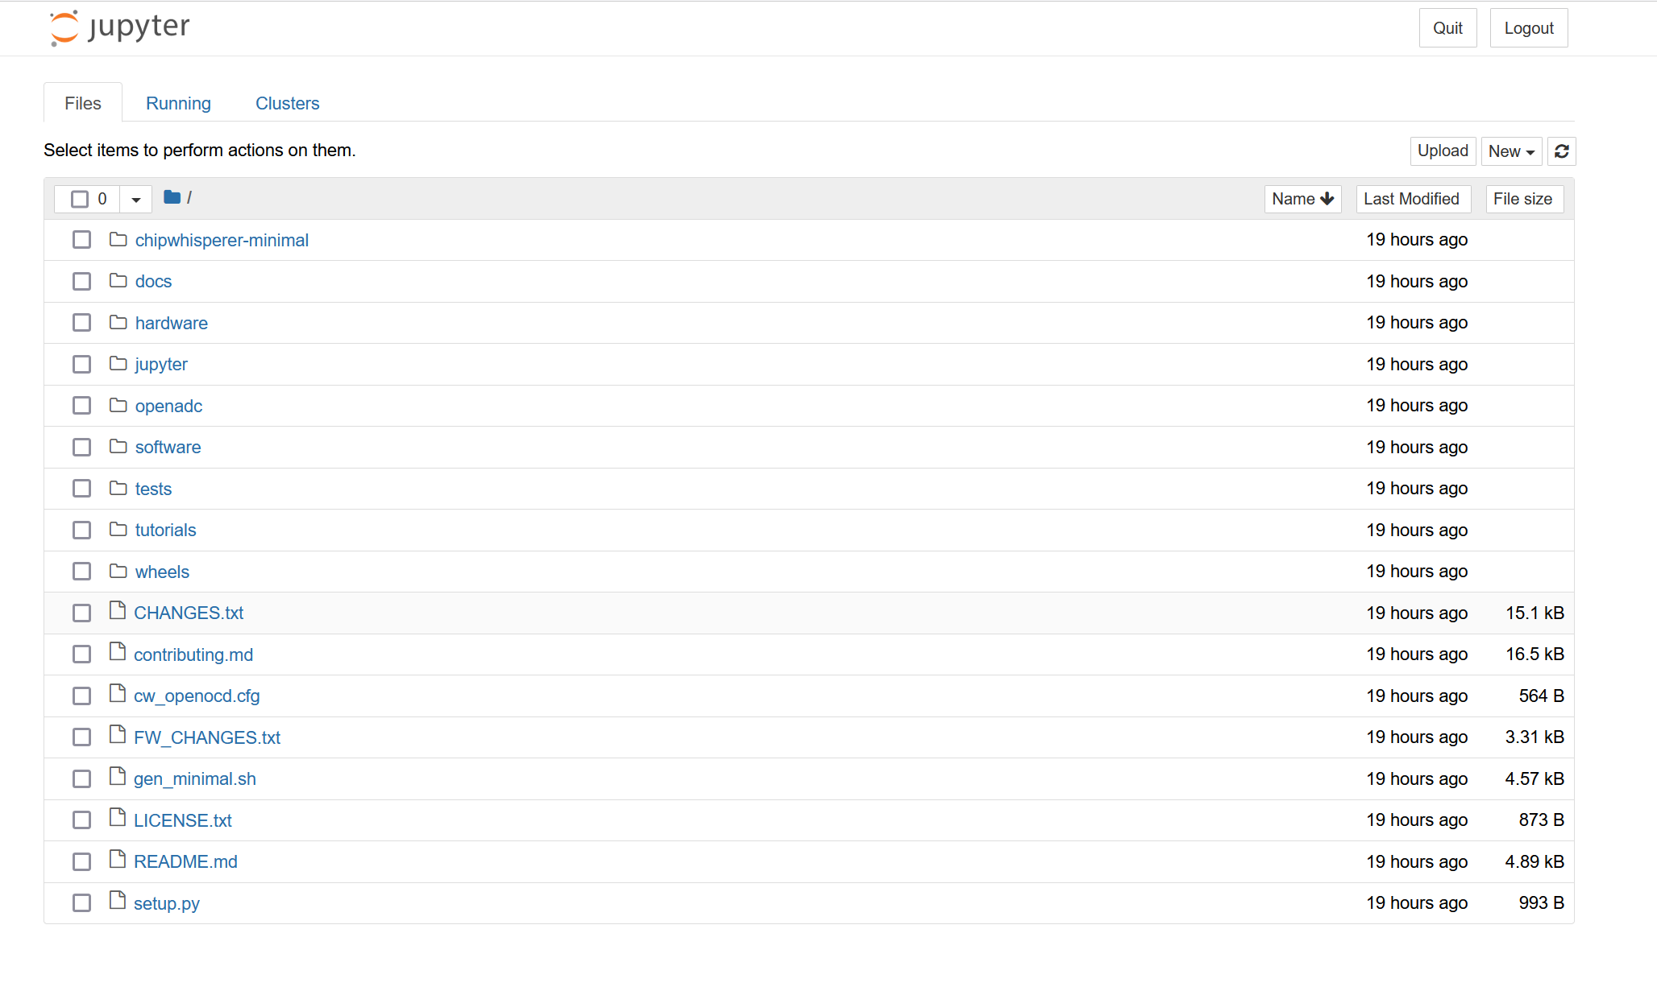
Part 2 - Install Chipwhisperer
Follow the instructions for the Bundled Installer on the previous slide
If installed correctly, a new window will be open in your browser
Once everything is running, run the following notebook:
0 - Introduction to Jupyter Notebooks.ipynb

Slide 8
Part 4 - Loading Traces
From the default view, enter the “jupyter” folder
Upload the 371 Lab 5 folder by clicking on ”Upload” in the top right and selecting the 371 Lab 5 folder from your device

Slide 9
Part 4 - Loading Traces
Now enter the uploaded folder
There should be three files:
371 Lab 5 Power Analysis.ipynb
Password_sim.ipynb
Passwords_full.p

Slide 10
Part 4 - Run Attack
Follow the instructions in the 371 Lab 5 Power Analysis notebook to carry out the attack
Pictures on the following slides should help guide you along to make sure you are on the right track

Slide 11
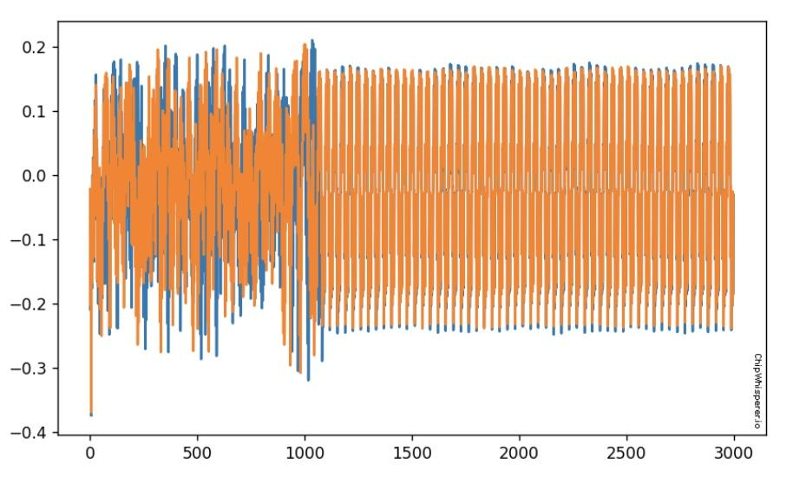
Part 4 – Exploration (plotting ‘h’ against all other passwords)

Slide 12
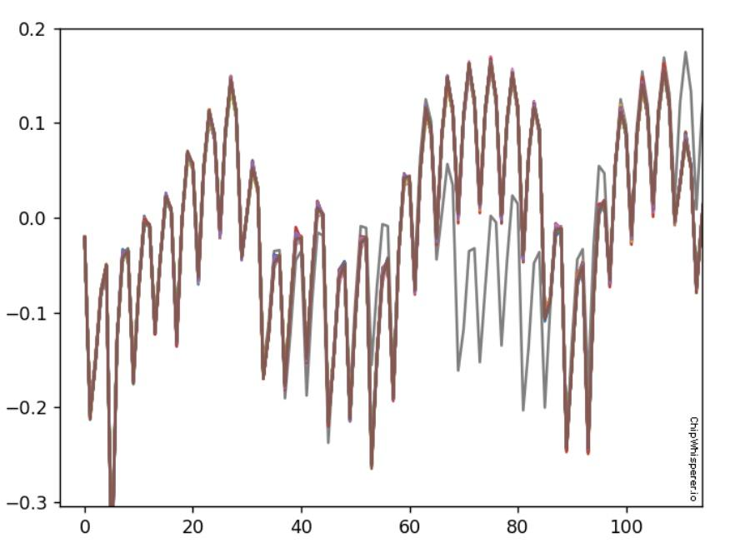
Part 4 – Plotting of correct trace against incorrect traces

Slide 13
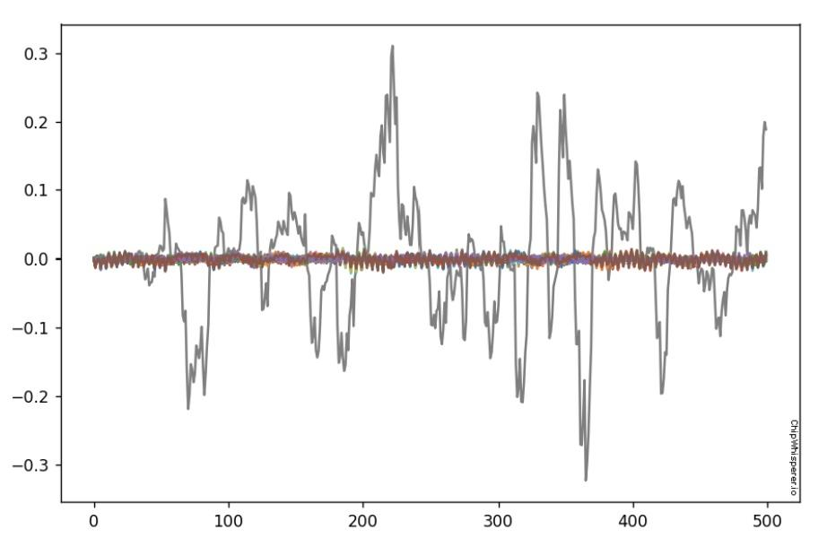
Part 4 – Automated plotting of outlier (correct) trace against other (incorrect) traces

Slide 14
Part 4 - Notes
You can export the graphs directly from Jupyter for your report
Some resources to help you:
https://chipwhisperer.readthedocs.io/en/latest/
https://github.com/newaetech/chipwhisperer

Slide 15
Part 5 - Report
For each attack, you must provide the following information in your report:
Images of the plots retrieved from each single letter attack step
Explanation of what the plots mean (IE: what do the axis mean? How are the traces distinguishable?)
Explanation of whether or not the attack was successful.
Additionally, you must submit the notebook that you modified
with your report
In your report you must also briefly explain what you did in this lab, including images and explanation of your code and results.
Do not forget to attach your modified notebook!
20

Slide 16
Best of luck!
21

